Slide 1
UNIT – FOUR
PART - ONE

Slide 2
Strategic management is the process of formulating and implementing strategies to accomplish longterm goals and sustain competitive advantage.
Competitive advantage arises when an organisation acquires or develops an attribute or combination of attributes that allows it to outperform its competitors.
Henry Mintzberg describes organisational strategy as ‘a pattern in a stream of decisions’.

Slide 3
Sustainable strategic competitiveness
Achieving and sustaining competitive advantage is a challenging task for even the largest organisations,
Sustainable competitive advantage is the hallmark of successful companies
Strategy provides the plan for allocating and using resources with consistent strategic intent — that is, with all organisational energies directed towards a unifying and compelling target or goal.
How environmental trends interact with each other to provide new opportunities and a changed business landscape.

Slide 4
Strategic management goals
A goal is a desired future state that the organization attempts to realize.
Sound strategy starts with having the right goal, the ultimate goal for any business should be superior profitability.
Monopoly environment exists there is only one organisation and no competition. This creates absolute competitive advantage, delivering sustainable and probably excessive business profits.
An oligopoly environment or oligopolistic competition is a market where a small number of competitors feel themselves constrained more by the actions of their rivals than by those of their customers.

Slide 5
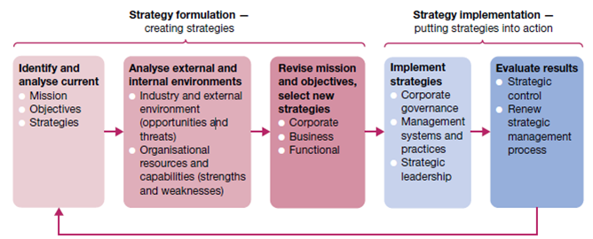
The strategic management process
Strategy formulation and implementation in the strategic management process

Slide 6
The first strategic management responsibility is strategy formulation, the process of creating strategy.
Peter Drucker associates this process with a set of five strategic questions:
What is our business mission? Who are our customers? What do our customers consider value? What have been our results? What is our plan?

Slide 7
The second strategic management responsibility is strategy implementation,
It requires decision — now. It imposes risk — now. It requires action — now. It demands allocation of resources, and above all, of human resources — now. It requires work — now.

Slide 8
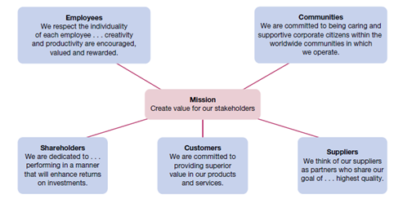
External stakeholders and the mission statement

Slide 9
Core values
Organisational culture is defined as the predominant value system of the organisation as a whole.
Shared values also help guide the behaviour of organisation members in meaningful and consistent ways
core values are driven by a desire to improve human life, achieve scientific excellence, operate with the highest standards of integrity, expand access to our products and employ a diverse workforce that values collaboration’.

Slide 10
According to Peter Drucker, the operating objectives of a business might include:
i. profitability — producing at a profit in business
ii. market share — gaining and holding a specific market share
iii. human talent — recruiting and maintaining a high‐quality workforce
iv. financial health — acquiring capital; earning positive returns
v. cost efficiency — using resources well to operate at low cost
vi. product quality — producing high‐quality goods or services
vii. innovation — developing new products and/or processes
viii. social responsibility — making a positive contribution to society.

Slide 11
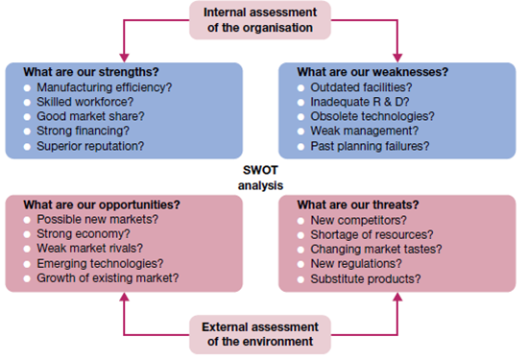
SWOT analysis of strengths, weaknesses, opportunities and threats

Slide 12
Analysis of industry and environment
A SWOT analysis is not complete until opportunities and threats in the external environment are also analysed. They can be found among macroenvironment factors such as technology, government, social structures and population demographics, the global economy and the natural environment. They can also include developments in the industry environment of resource suppliers, competitors and customers.
Opportunities may exist as possible new markets or a strong economy;
Threats may be identified in such things as the emergence of new competitors or technologies, resource scarcities, changing customer tastes and new government regulations, among other possibilities.

